Slide 1

AI App/ Project Name
User Manual
Author: Sarthak Sangare
Notes:
Preworks course home assignments

Slide 2
Table of Contents
Acknowledgements
About Me
My Journey
About App
App Walkthrough
Contact Person

Slide 3
Acknowledgements
I want to thank my teachers - especially Ms. Sanjana for guiding me. I would like to thank Dr. Ken Kahn and Clevered for giving me this opportunity. I also want to thank my parents for helping me realize the opportunity.

Slide 4
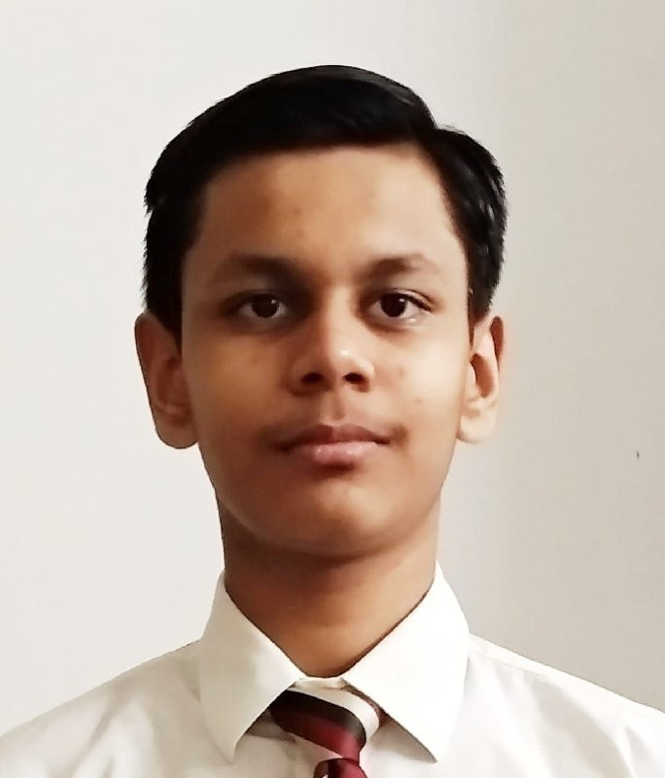
About Me..
Student’s Photograph
Student’s Introduction
My Name is Sarthak. I’m a huge fan of computers and technology. I spend my free time learning new programming languages and working on personal projects.

Slide 5
About My Internship Journey with Clevered..
During my internship at Clevered, I collaborated with a supportive team, tackling exciting AI projects. The positive atmosphere fostered creativity and growth, making each day an inspiring learning experience.

Slide 6
About App..
App’s Main Menu
The Main Menu consists of three simple buttons - Upload File, Analyze Data, and Find Capable Donor.
App’s Introduction
The ‘Find Me a Capable Donor’ App is an app that connects those in need with compassionate donors to create meaningful change.

Slide 7
How do I use the App?

Slide 8
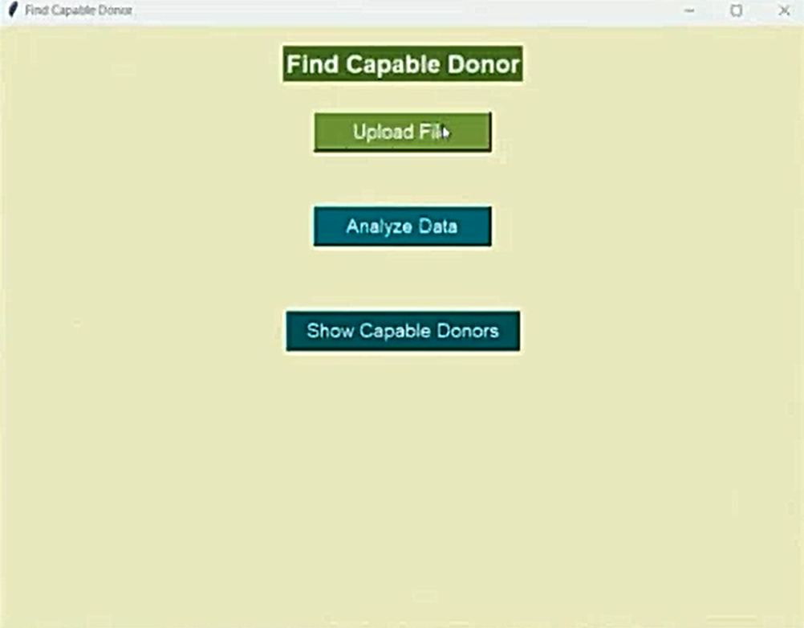
Option Name(This will be repeated for each option of the App)
Screenshot/ Pic of each option/screen of the App
Steps to use the same
First Click on ‘Upload File’
Select Appropriate File
Click on Analyze Data
Click on ‘Show Capable Donors’

Slide 9
Contact Person
Please reach out to Sarthak Sangare at sarthak.sangare18@gmail.com for any questions/ concerns/ suggestions on the App

Slide 10
Thank you!

